Slide 1
Detailed Design Lightning Talk
sdmay25-26 Bryce Rega, Marek Jablonski, Gavin Patel, Jonah Frosch, Long Yu Cost-Effective and Easily Configurable High Voltage Motor Controllers for Automotive Use
October 31st, 2024

Slide 2
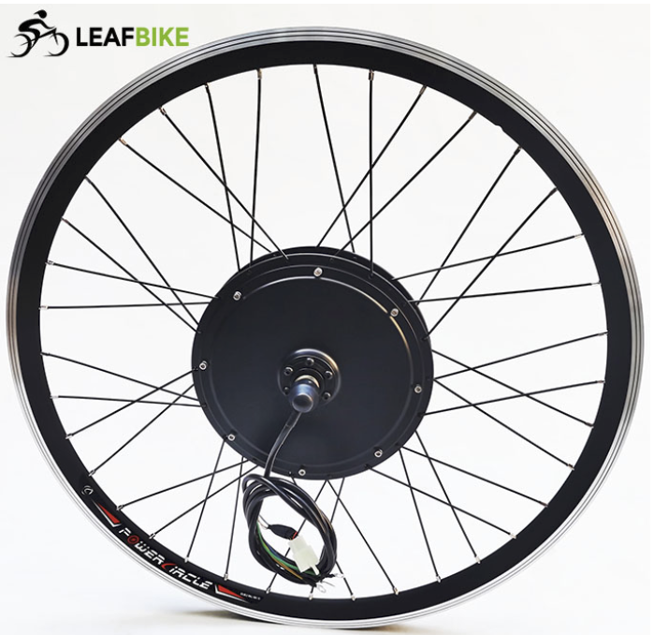
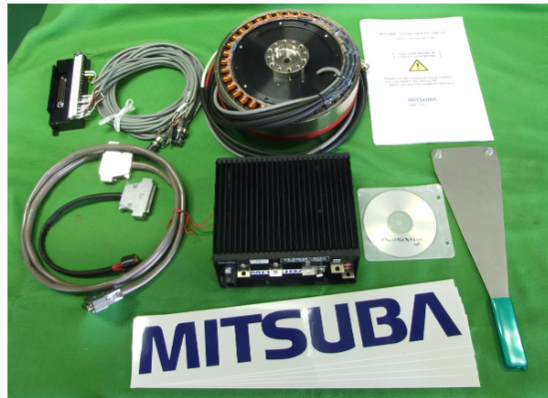
Project Overview
Custom High Voltage Motor Controller
Low Total cost for controller when compared to market options
Develop a GUI for interfacing and configuring controller
Compatible with many different applications

Slide 3
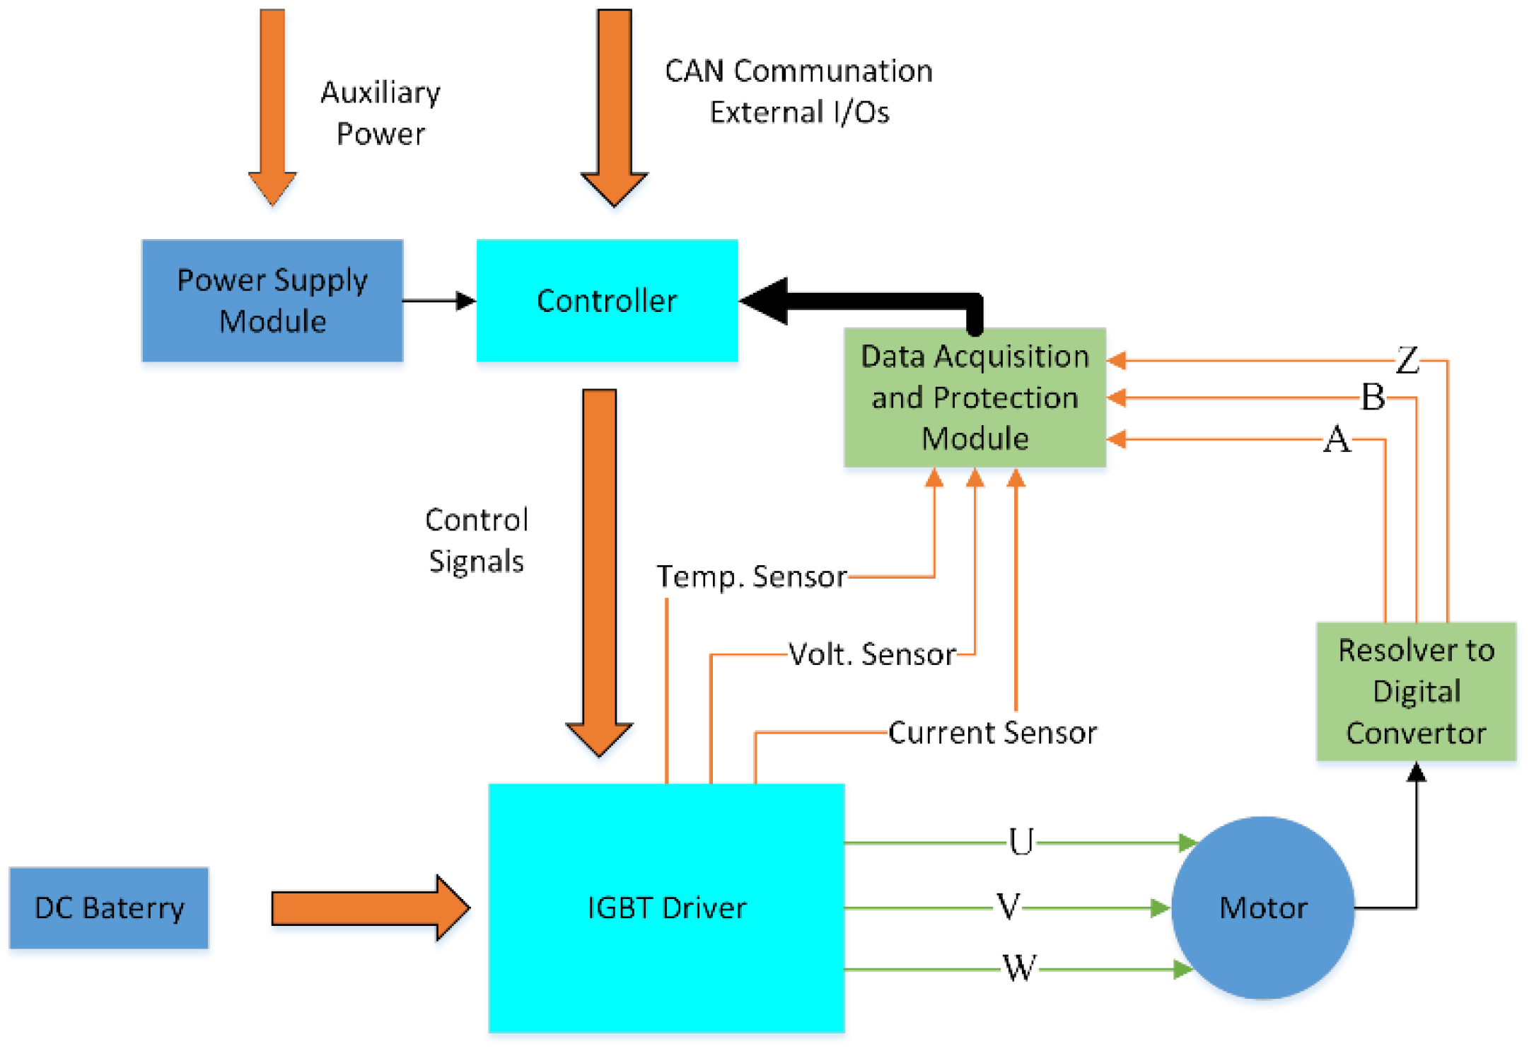
In this project will we be designing the architecture and implementation of a motor controller for lightweight automotive use.

Slide 4
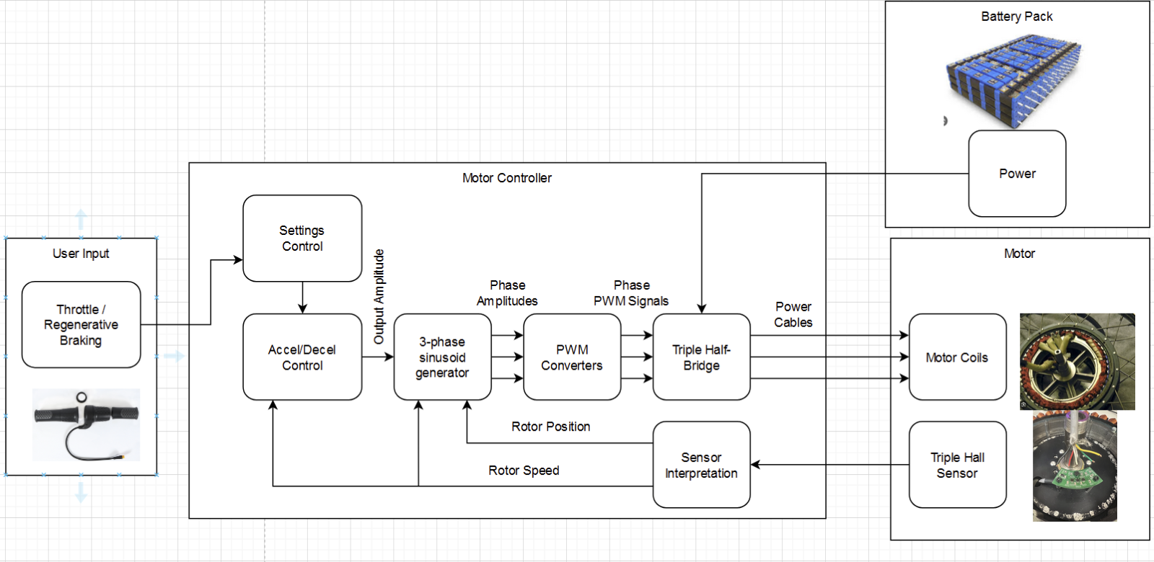
High Level Design
Take inputs from a user throttle / braking and a DC voltage source for power
Output a 3 phase sinusoidal waveform for driving motors
Software drives the motor and receives data back through a HALL effect sensor in a feedback loop

Slide 5
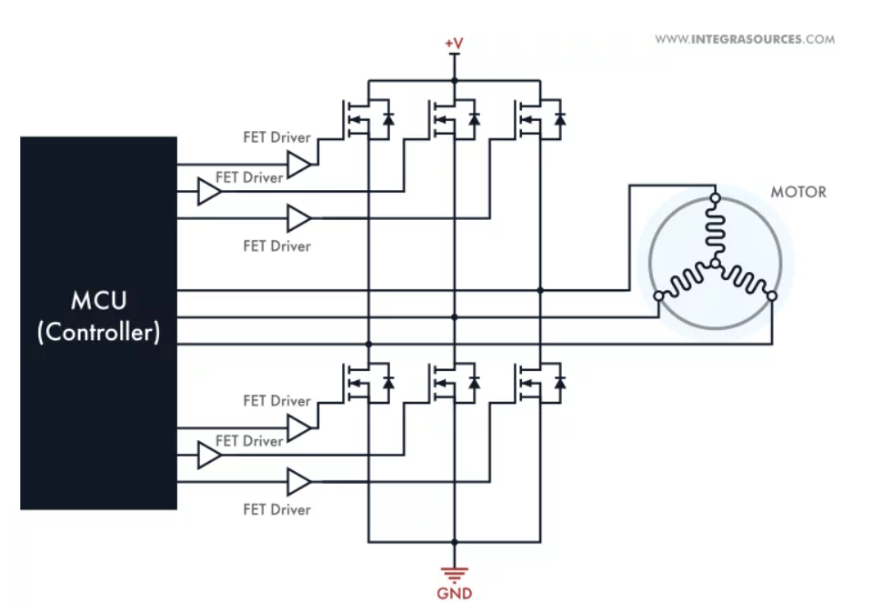
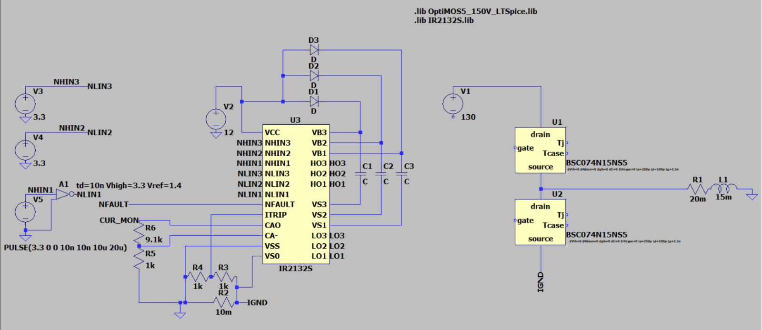
Hardware Design
Component selection: MOSFET over IGBT (More efficient)
Test electrical and thermal performance of the circuit using LTspice
Creating an initial prototype of the PCB
Validate that the hardware responds correctly to the software inputs

Slide 6
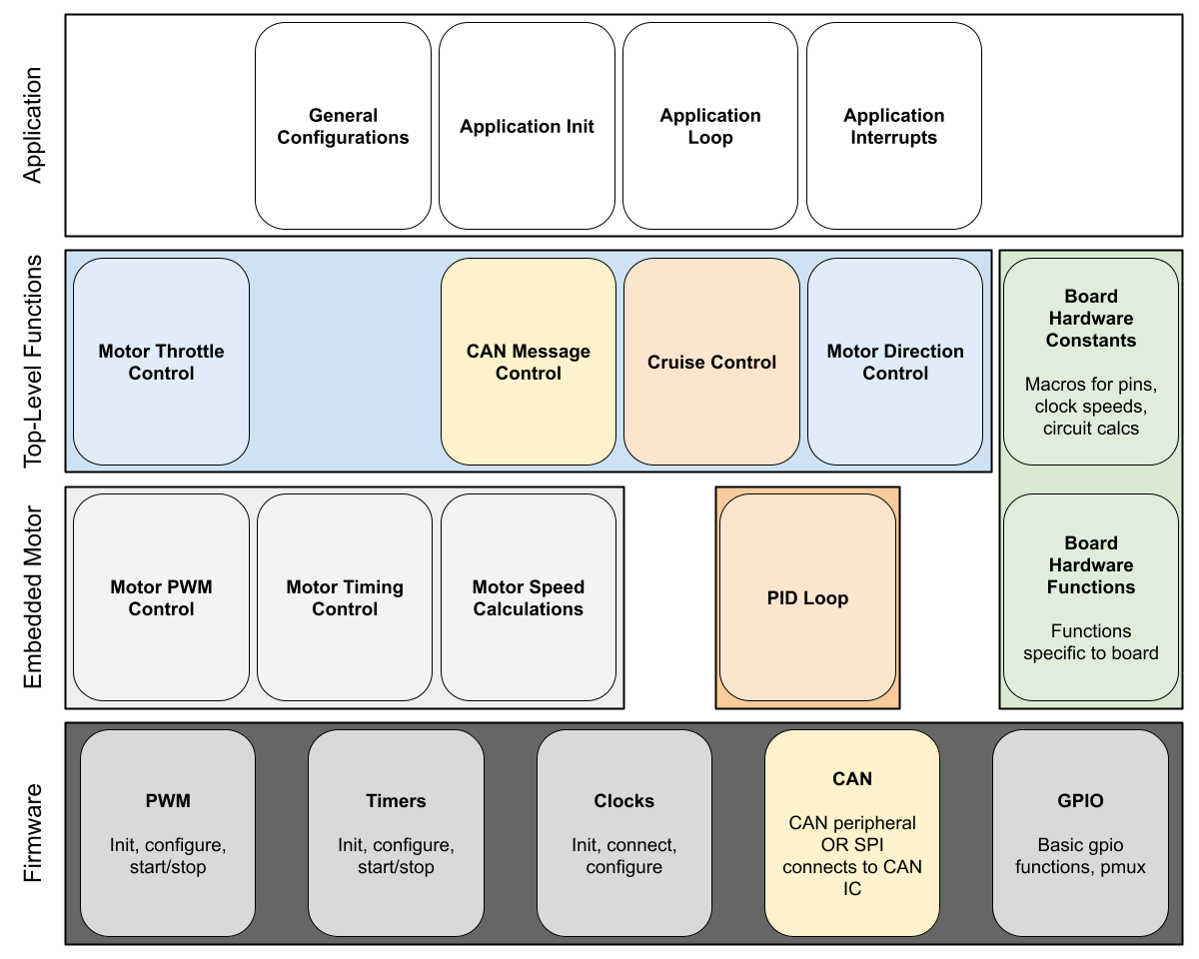
Software Design
Modular, layered design
Top-level general application
Good for configurations
Middle layer motor behavior
The thick of what makes a motor work
Bottom layer firmware
Support dev board's ST chip
Support other chips (ATSAMC21)
Support on-board CAN and external CAN using SPI

Slide 7
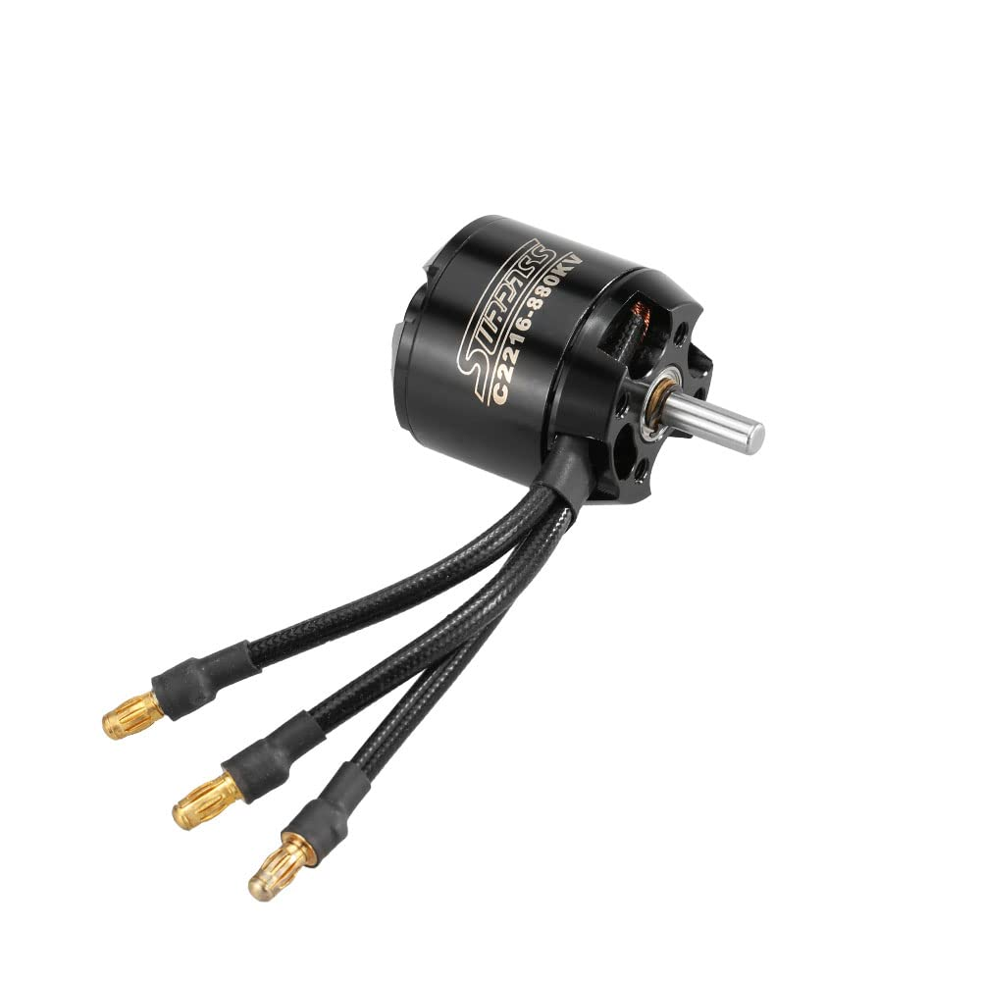
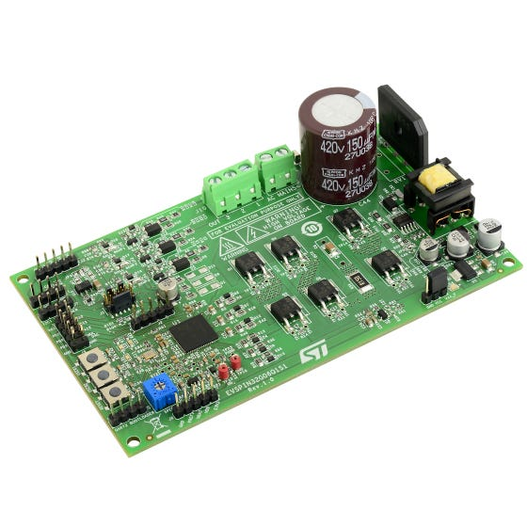
Functionality
Our design will function by spinning the motor that it is connected to in proportion of the input throttle.
User input is received via either CAN bus communication or GPIO, which is configurable in the device settings.
The device will also operate based on feedback from the HALL sensor, which will provide information on the motor, such as its current speed. This will be used in order to more accurately drive the motor and for cruise control.

Slide 8
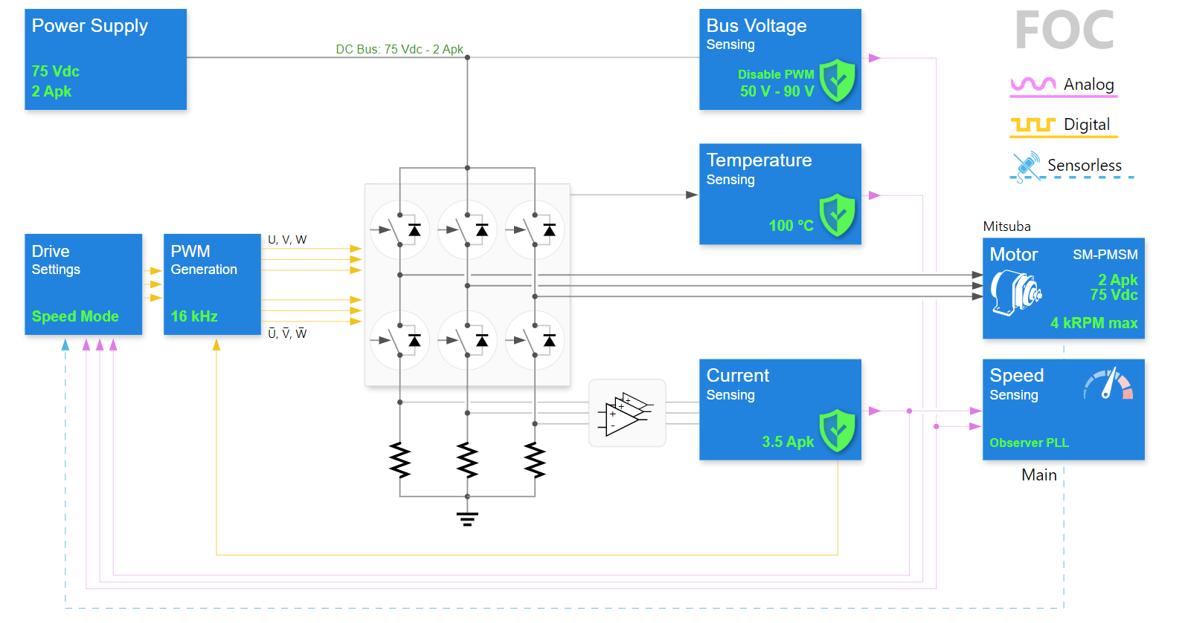
Technology Considerations
LT Spice for circuit testing and development
Free usage and we have common familiarity
ST Motor Workbench & Libraries
Good for initial development, lots of customizability
Often poor documentation

Slide 9
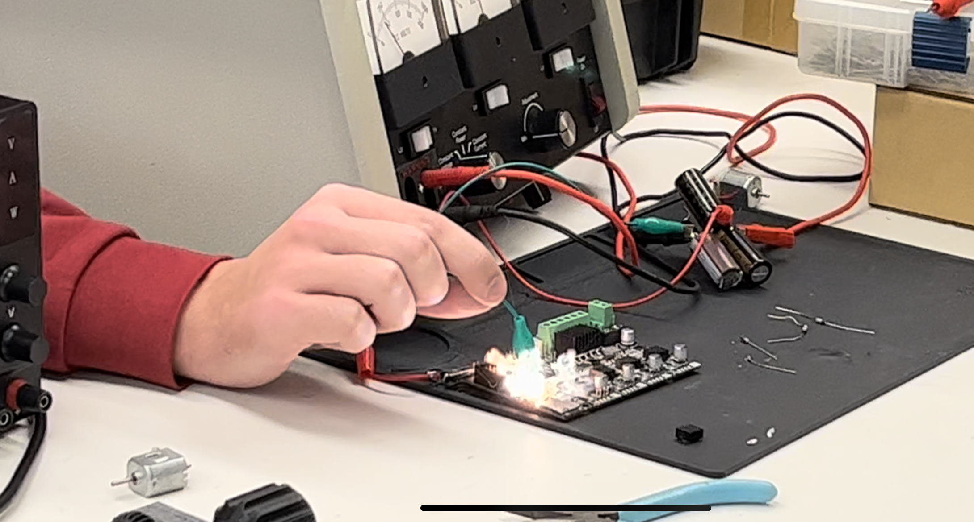
Areas of Concern and Development
We are currently in the development phase, so we are using a development board to test what features and capabilities our final project will have to have.
Currently, our timetable is very condensed so large setbacks can seriously affect whether we can finish this project with all the desired components.

Slide 10
Conclusion
We plan to develop the hardware and software for a highly configurable motor controller. We plan to have built-in cruise control, user input from either CAN messages or GPIO pins, and built-in safety features.

